Slide 1
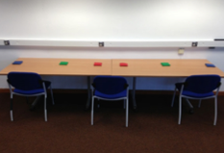
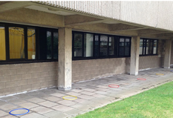

Table task
Table task
Experiment 1A
Throwing task
Small talk
Table task
Experiment 1B
Verbal FDD problem
Throwing task
Arithmetic problems
Throwing task
skill test +
Throwing task
Table task
Experiment 1C
Throwing task
+ skill test
Sodoku
Detection task
Guided practice
Experiment 2
Acuity mapping
Detection task
Unguided practice

